Slide 1
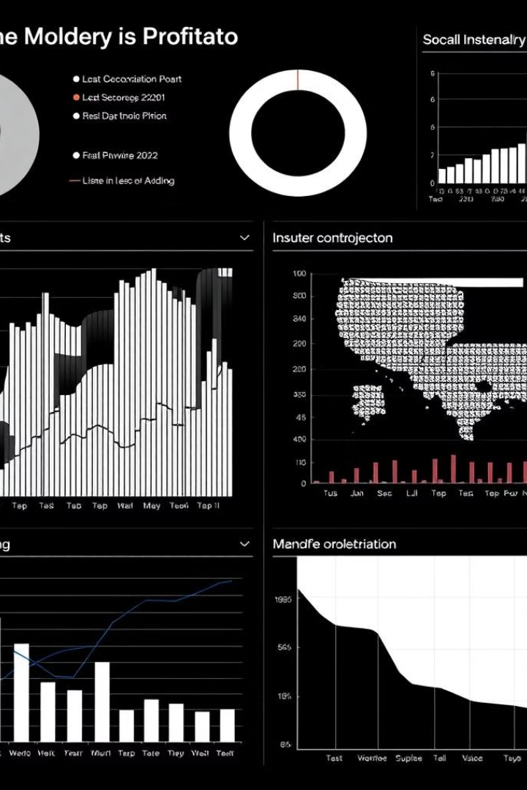
Exploring Your Dataset
Embark on a journey through the dataset as we uncover its key features and unlock the potential for a groundbreaking Machine Learning solution.

Slide 2
Description of the Dataset
Source
Description
The dataset originates from [LINK: https://www.kaggle.com/datasets/alfathterry/telco-customer-churn-11-1-3].
This dataset provides customer data for a telecom company, including demographic details, services subscribed, account information, and whether the customer churned (left the service).

Slide 3
Dataset Overview
Overview
customer_id
String
Unique identifier for each customer.
Nominal
gender
String
Gender of the customer (Male/Female).
Nominal
senior_citizen
Integer (0/1)
Indicates if the customer is a senior citizen (1: Yes, 0: No).
Nominal
partner
String
Indicates if the customer has a partner (Yes/No).
Nominal
dependents
String
Indicates if the customer has dependents (Yes/No).
Nominal
tenure
Integer
Number of months the customer has stayed with the company.
Discrete
phone_service
String
Indicates if the customer has phone service (Yes/No).
Nominal
multiple_lines
String
Indicates if the customer has multiple lines (Yes/No/No phone service).
Nominal
internet_service
String
Type of internet service (DSL, Fiber optic, None).
Nominal
online_security
String
Indicates if the customer has online security (Yes/No/No internet service).
Nominal
online_backup
String
Indicates if the customer has online backup (Yes/No/No internet service).
Nominal
device_protection
String
Indicates if the customer has device protection (Yes/No/No internet service).
Nominal
tech_support
String
Indicates if the customer has tech support (Yes/No/No internet service).
Nominal
streaming_tv
String
Indicates if the customer has streaming TV service (Yes/No/No internet service).
Nominal
streaming_movies
String
Indicates if the customer has streaming movies service (Yes/No/No internet service).
Nominal
contract
String
Contract type (Month-to-month, One year, Two year).
Ordinal
paperless_billing
String
Indicates if the customer has opted for paperless billing (Yes/No).
Nominal
payment_method
String
Payment method (Electronic check, Mailed check, Bank transfer, Credit card).
Nominal
monthly_charges
Float
Monthly charges incurred by the customer.
Continuous
total_charges
Float
Total charges incurred by the customer (calculated over the entire tenure).
Continuous
churn
String
Indicates if the customer has churned (Yes/No).
Nominal

Slide 4
Predicting Customer Churn Using Machine Learning
Our goal is to build a machine learning model capable of accurately predicting which telecom customers are most likely to churn. This involves identifying key features in the dataset that are highly correlated with churn, such as contract type, payment method, monthly charges, and customer service interactions. We will then develop a model that can learn these patterns and predict future churn behavior.
Accurate churn prediction allows the company to proactively engage at-risk customers with retention strategies, such as offering discounts, upgrading services, or personalized customer support. This proactive approach ultimately reduces churn rate, improves customer lifetime value, and increases overall profitability.
Our approach to feature selection will involve both univariate analysis (e.g., chi-squared tests for categorical variables, t-tests for numerical variables) to identify individual features significantly associated with churn and multivariate analysis (e.g., recursive feature elimination) to account for interactions and redundancy amongst features. This process will help us choose the most informative features and create an efficient and accurate model.

Slide 5




Sketch of the Machine Learning Solution
Model Training
1
We will train various machine learning algorithms, including Random Forest and Gradient Boosting, to build predictive models. Model selection will be based on performance metrics such as accuracy, precision, and recall.
Data Preprocessing
2
This crucial step involves handling missing values, encoding categorical variables (e.g., using one-hot encoding), and scaling numerical features (e.g., using standardization or min-max scaling). The goal is to prepare the data for optimal model training.
Feature Engineering
3
We will create new features from existing ones to potentially improve model accuracy. This might involve combining features, creating interaction terms, or generating polynomial features. Feature importance analysis will guide this process.
Model Evaluation
4
The model's performance will be rigorously evaluated using appropriate metrics on a held-out test set. Techniques like k-fold cross-validation will be employed to ensure robust evaluation and prevent overfitting. Hyperparameter tuning will be performed to optimize the model's performance.
By following this structured approach, we aim to develop a robust and accurate machine learning model for predicting customer churn, enabling proactive intervention and improved customer retention.

Slide 6
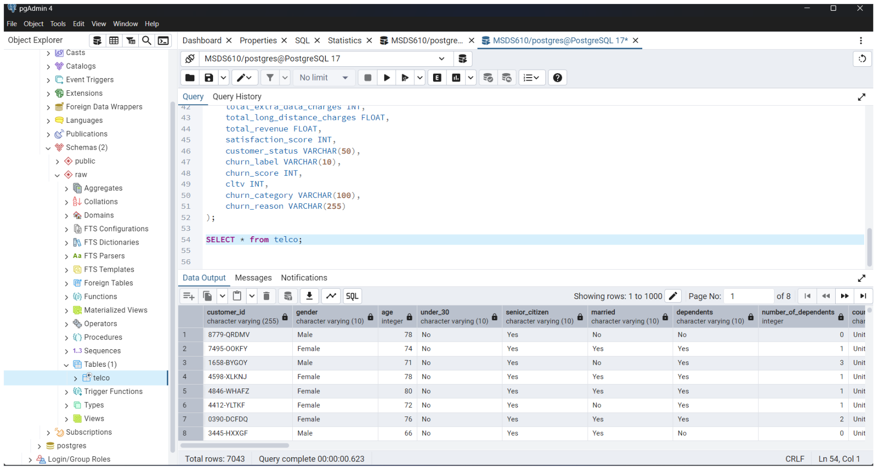
Screenshot of Data in pgAdmin
This screenshot shows how the data is stored and organised in pgAdmin, our database management tool. We can query and manipulate the data here to prepare it for training our machine learning model.
Specific data preparation steps in pgAdmin include cleaning, transforming, and potentially joining data from multiple tables. We may also create new views or materialized views for efficient data access during model training. Data quality checks are also performed to ensure data consistency and accuracy.

Slide 7
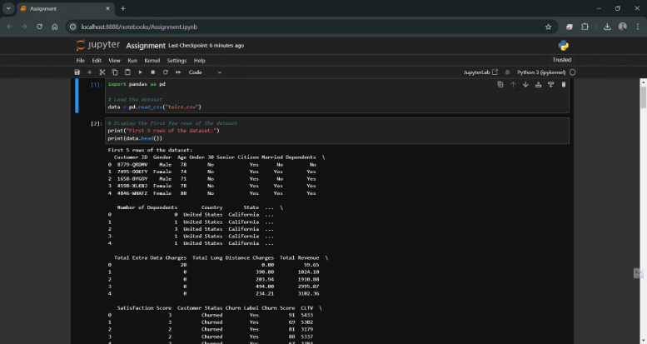
Data Loading and Retrieval in Jupyter Notebook
This screenshot shows the process of loading and retrieving the telecom customer churn dataset within a Jupyter Notebook environment. The code utilizes the pandas library to efficiently read the data from a CSV file. Initial data cleaning steps, such as handling missing values and data type conversions, are performed directly within the notebook before the data is displayed in a table for review and analysis. Exploratory data analysis (EDA) techniques are then applied to gain insights into the data's characteristics and inform further feature engineering and model selection steps. This ensures data quality and prepares the dataset for effective machine learning model training.

Slide 8
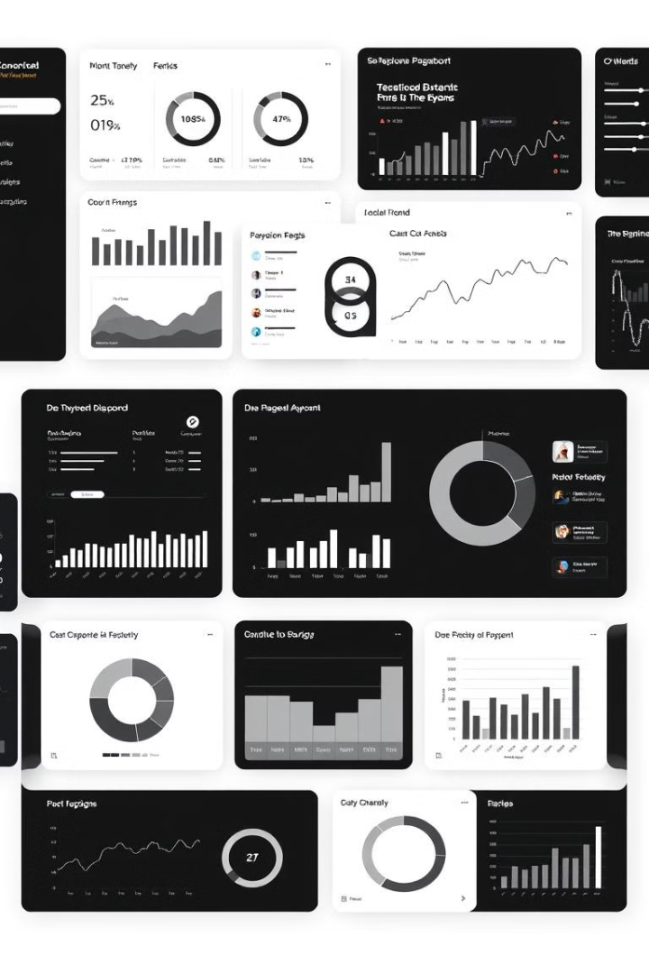
Key Takeaways
By leveraging machine learning, we can effectively predict customer churn, empowering proactive retention strategies and improving customer lifetime value.

